Slide 1
Docker en EC2
Carlos Zelada

Slide 2
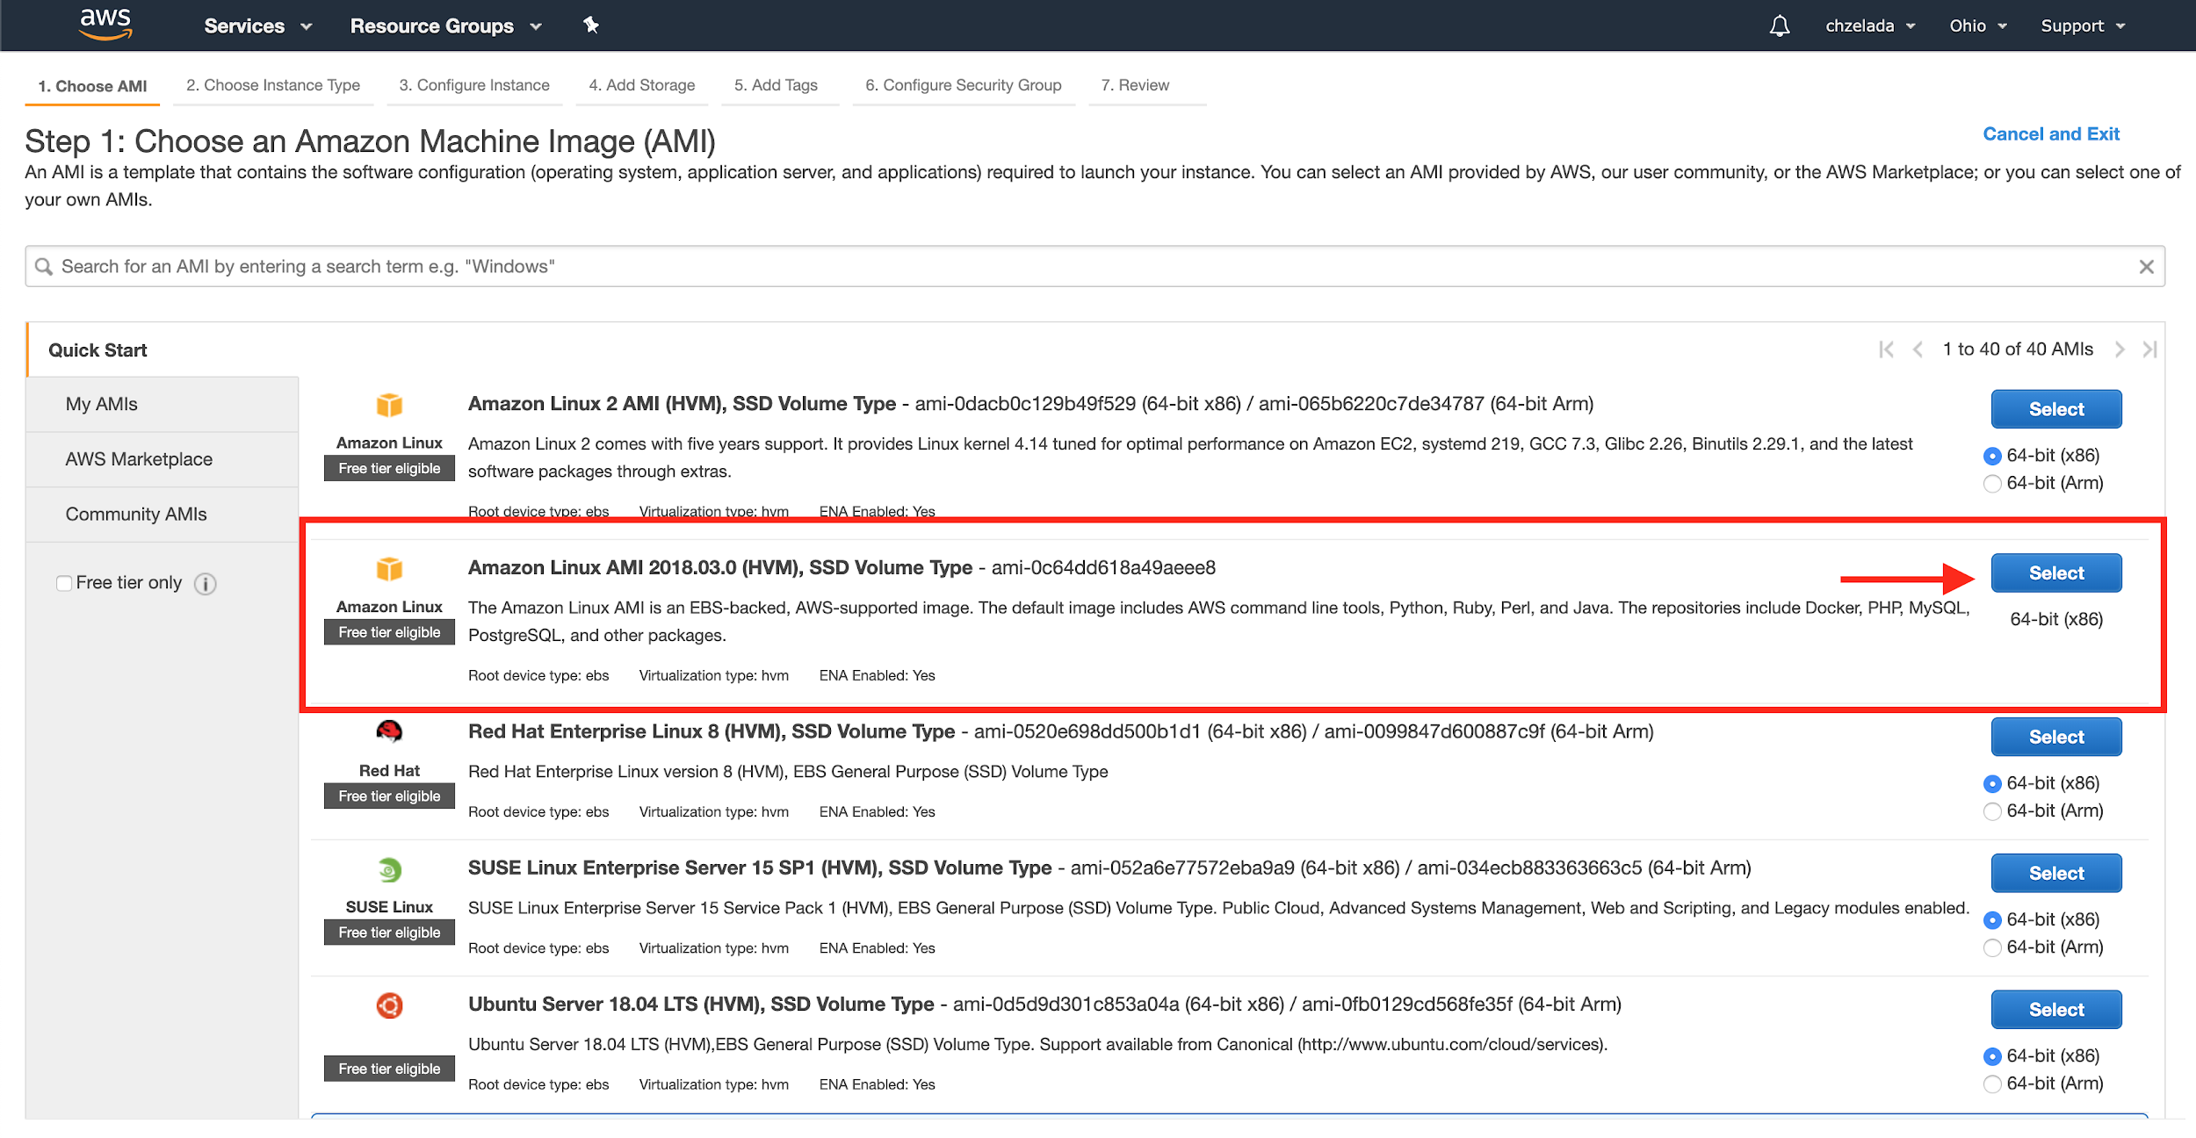

Slide 3
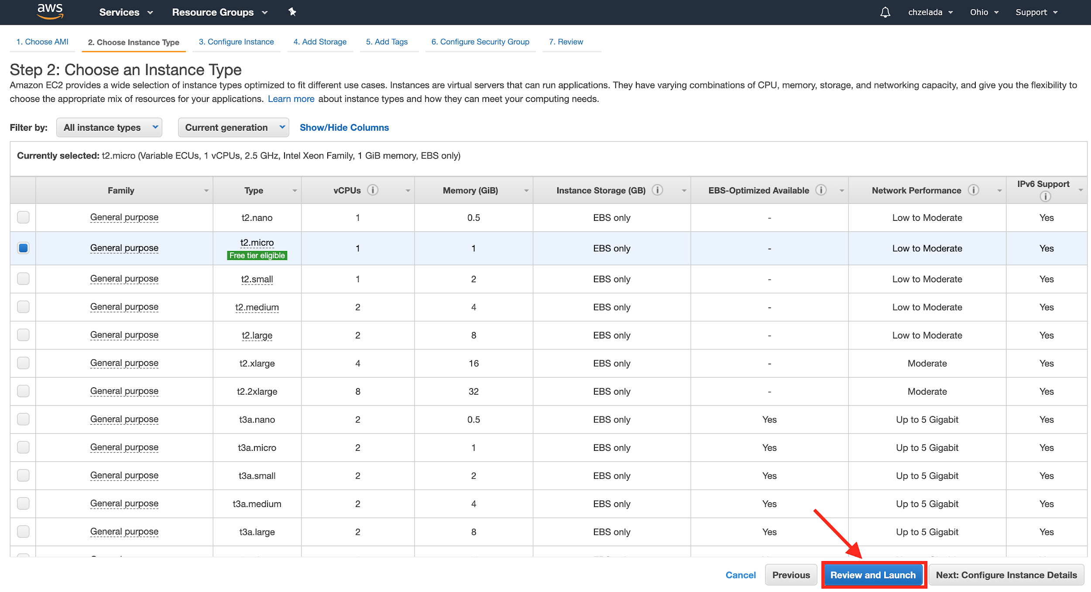

Slide 4
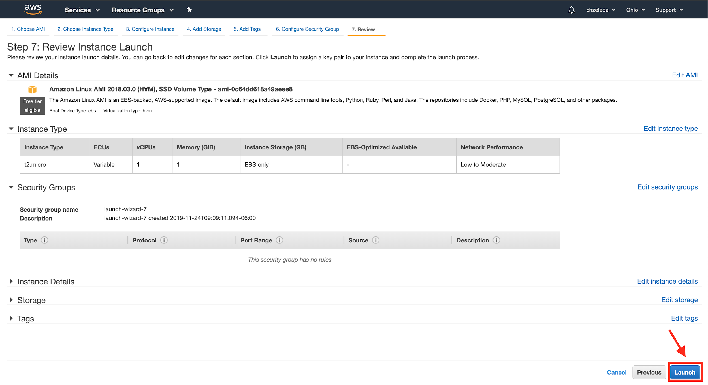

Slide 5
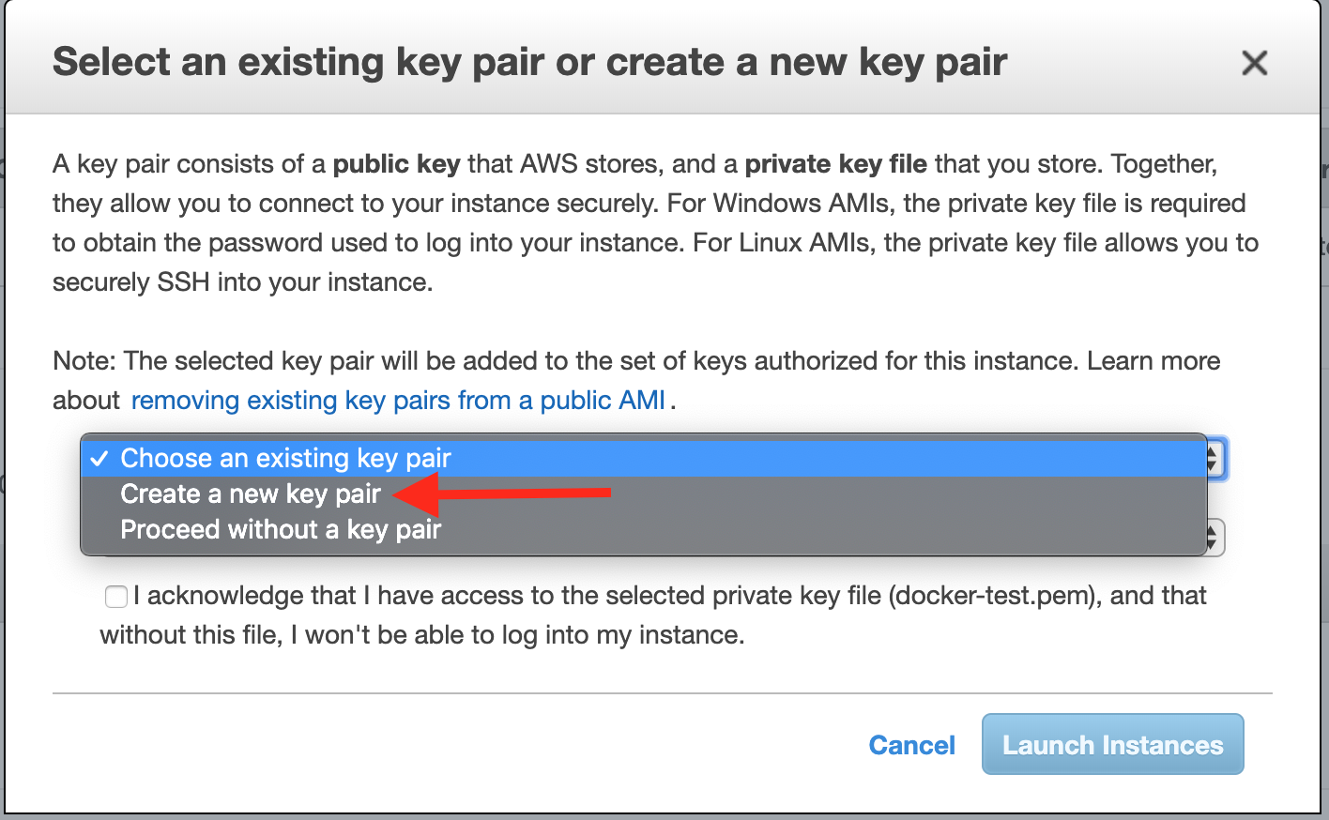

Slide 6
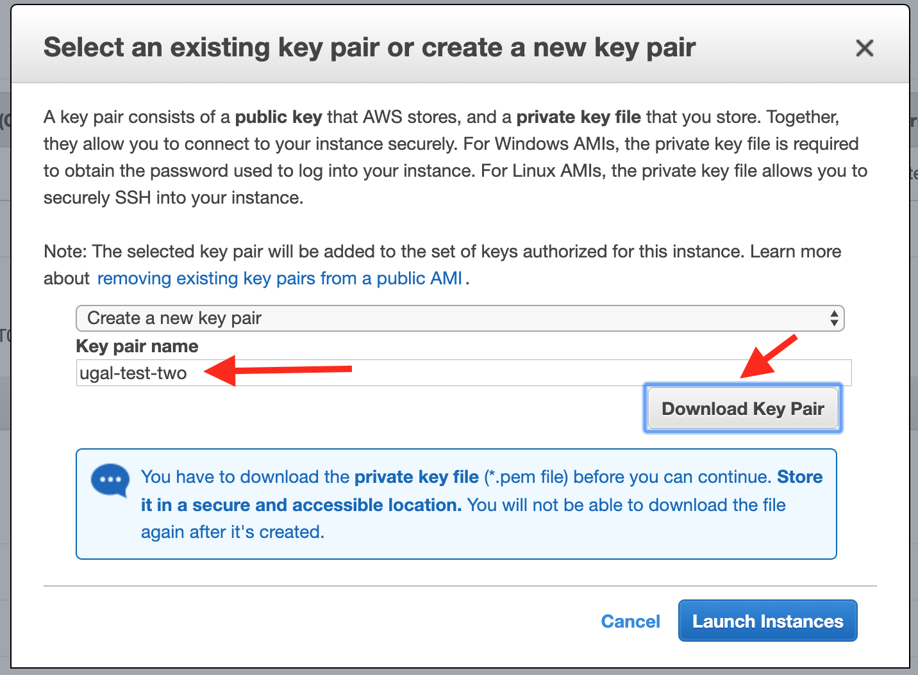

Slide 7
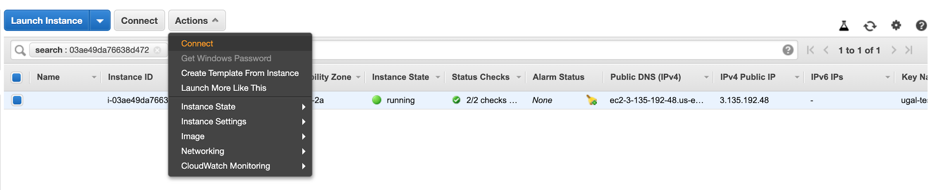

Slide 8
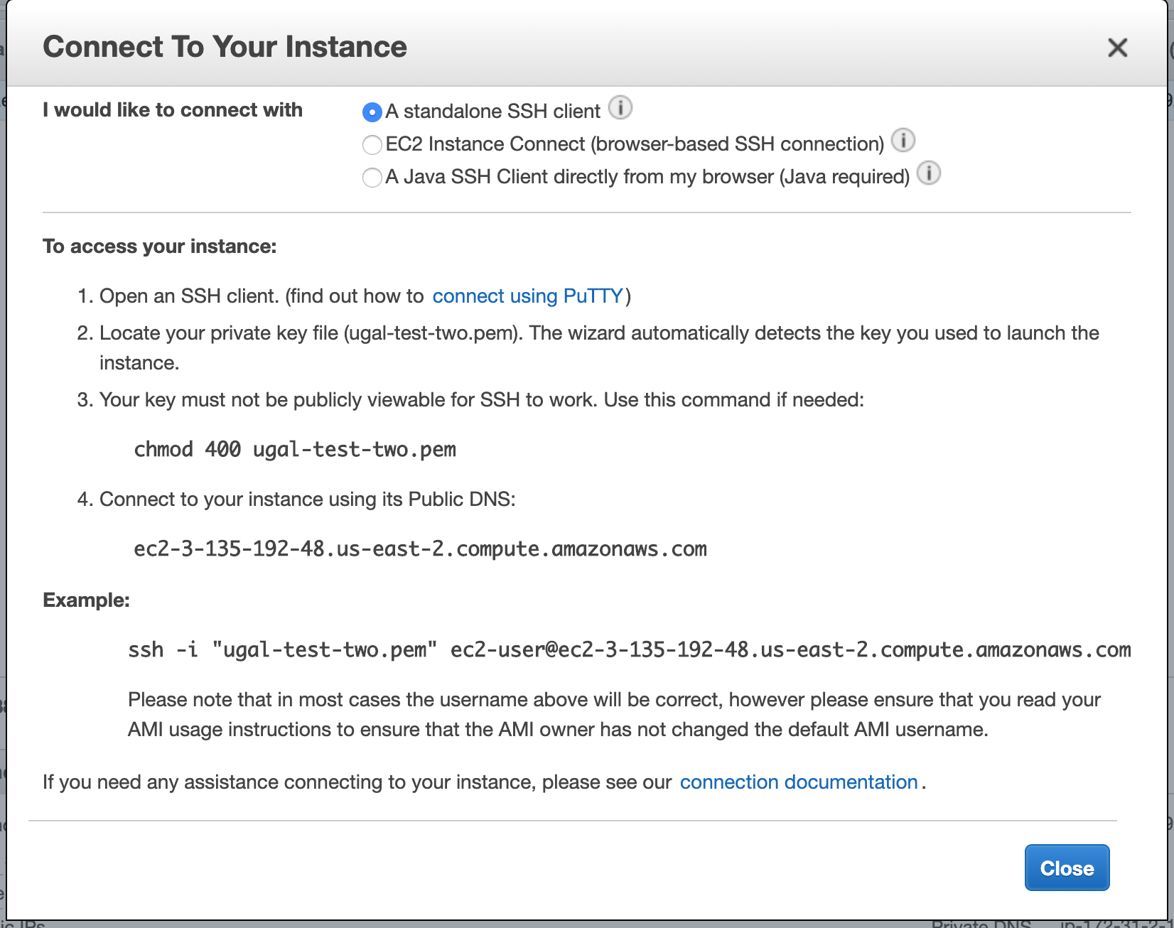

Slide 9
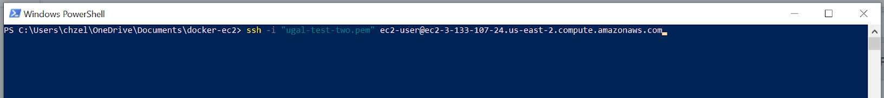


Slide 10



Slide 11

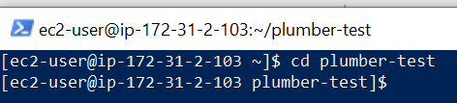

Slide 12
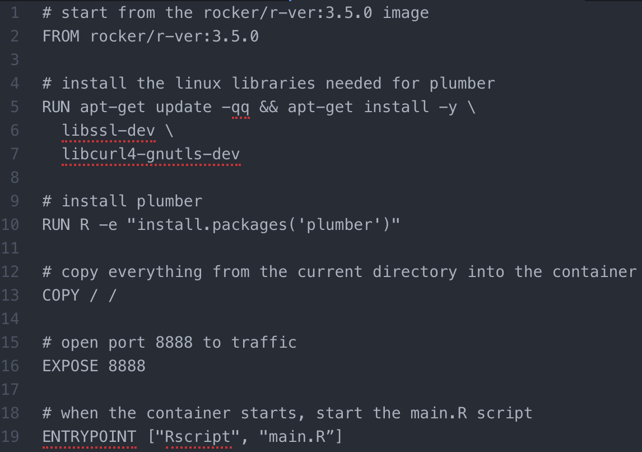
:wq - write and quit
:q! - quit no save
[ESC] dd - delete line
i - editar
[ESC] - Salir edicion
mas

Slide 13

Plumber

